Slide 1
First Hop Redundancy Protocols

Slide 2
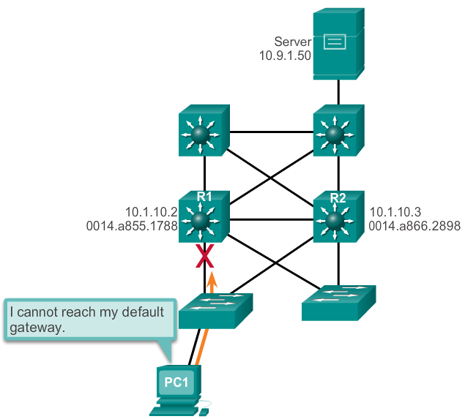
Concept of First-Hop Redundancy Protocols Default Gateway Limitations
If the default gateway cannot be reached, the local device is unable to send packets off the local network segment.
Even if a redundant router exists that could serve as a default gateway for that segment, there is no dynamic method by which these devices can determine the address of a new default gateway.
Notes:
2.4.1.1 Default Gateway Limitations

Slide 3
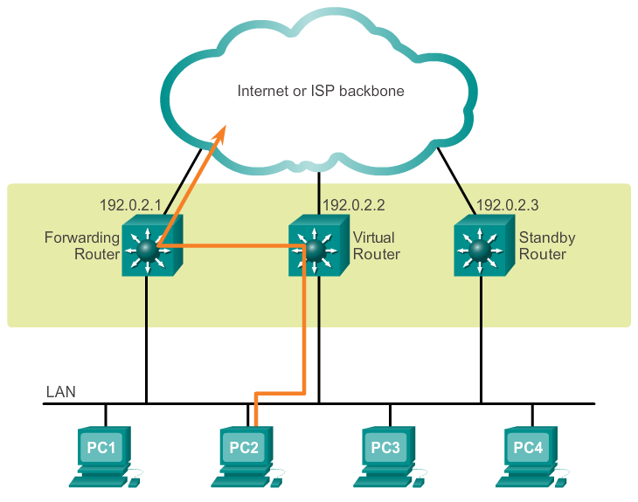
Concept of First-Hop Redundancy Protocols Router Redundancy
Multiple routers are configured to work together to present the illusion of a single router to the hosts on the LAN.
The ability of a network to dynamically recover from the failure of a device acting as a default gateway is known as first-hop redundancy.
Notes:
2.4.1.2 Router Redundancy

Slide 4
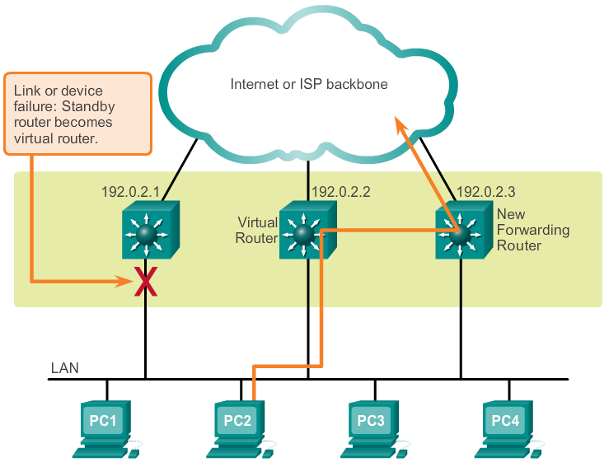
Concept of First-Hop Redundancy Protocols Steps for Router Failover
Notes:
2.4.1.3 Steps for Router Failover
Virtual router is configured as the default router for each host on the LAN segment

Slide 5
Varieties of First-Hop Redundancy Protocols First-Hop Redundancy Protocols
Hot Standby Router Protocol (HSRP)
HSRP for IPv6
Virtual Router Redundancy Protocol version 2 (VRRPv2)
VRRPv3
Gateway Load Balancing Protocol (GLBP)
GLBP for IPv6
ICMP Router Discovery Protocol (IRDP)
Notes:
2.4.2.1 First-Hop Redundancy Protocols
HSRP, GLBP = Cisco proprietary
VRRP is standards based. Very similar operation to HSRP.

Slide 6
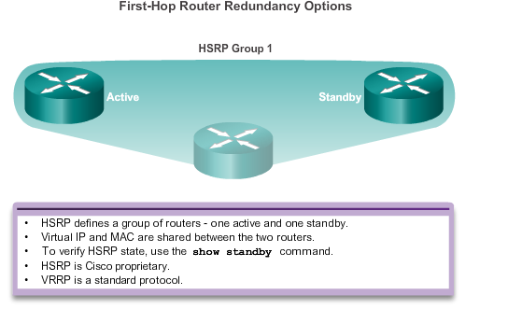
Varieties of First-Hop Redundancy Protocols First-Hop Redundancy Protocols
Notes:
2.4.2.1 First-Hop Redundancy Protocols (cont.)

Slide 7
HSRP
HSRP routers negotiate active and standby routers.
HSRP routers send Hello packets to each other every 3 sec (default) to determine if peers are alive
Default hold time = 10sec
Uses gratuitous ARP to update switch mac-address tables upon failover
Notes:
Gratuitous ARP = ARP reply for which no request is made. Destination = ff:ff:ff:ff:ff:ff

Slide 8
HSRP Configuration
R1(config)# interface g0/1
R1(config-if)# standby 1 ip 192.168.1.254
R1(config-if)# standby 1 priority 150
R1(config-if)# standby 1 preempt
R2(config)# interface g0/1
R2(config-if)# standby 1 ip 192.168.1.254

Slide 9
HSRP
The highest number (1 to 255) represents the highest priority (most likely to become the active router). Default is 100.
Preempt = when the local router has a higher priority than the active router, it assumes control as the active router (important when tracking).

Slide 10
HSRP Tracking
R1(config)# interface g0/1
R1(config-if)# standby 1 ip 192.168.1.254
R1(config-if)# standby 1 priority 105
R1(config-if)# standby 1 track Serial0
R3(config-if)# standby 1 preempt
R2(config)# interface g0/1
R2(config-if)# standby 1 ip 192.168.1.254
R2(config-if)# standby 1 preempt
If serial 0 fails then the priority will be decremented by 10 (default)
Notes:
Preempt allows R2 to become primary immediately

Slide 11
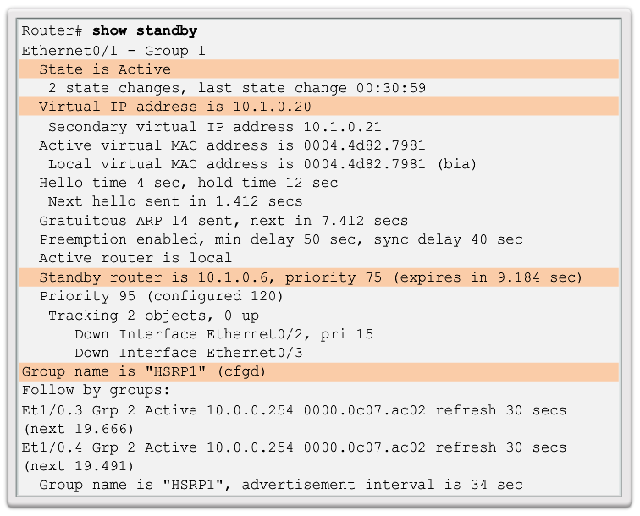
FHRP Verification HSRP Verification
Notes:
2.4.3.1 HSRP Verification

Slide 12
Gateway Load Balancing Protocol (GLBP)
Active / Active model
Each router has a virtual MAC address (VMAC)
One router per group acts as active virtual gateway (AVG)
AVG responds to all ARP requests with a different VMAC

Slide 13
GLBP Config Example
R1(config)# interface g0/1
R1(config-if)# glbp 1 ip 192.168.1.254
R1(config-if)# glbp 1 priority 105
R2(config-if)# glbp 1 load-balancing host-dependent
R3(config-if)# glbp 1 preempt
R2(config)# interface g0/1
R2(config-if)# glbp 1 ip 192.168.1.254
R2(config-if)# glbp 1 load-balancing host-dependent
Notes:
Supports tracking, authentication, weighting
load-balancing = round-robin (between AVFs) is default. Host-dependent = src MAC of host used to ensure same AVF is used per host

Slide 14
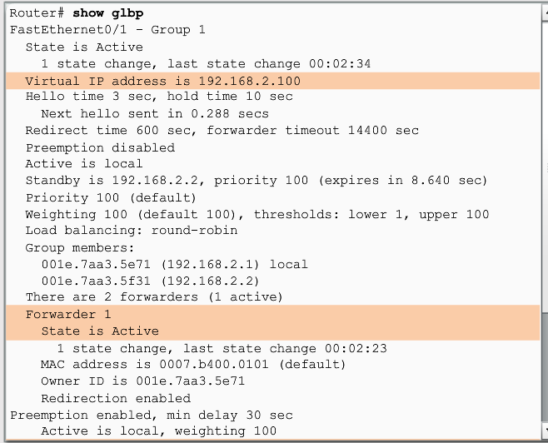
FHRP Verification GLBP Verification
Gateway Load Balancing Protocol (GLBP) is a Cisco proprietary solution to allow automatic selection and simultaneous use of multiple available gateways in addition to automatic failover between those gateways.
Notes:
2.4.3.2 GLBP Verification

Slide 15
Resources
HSRP
http://www.cisco.com/c/en/us/td/docs/switches/lan/catalyst3560/software/release/12-2_52_se/configuration/guide/3560scg/swhsrp.html
GLBP
http://www.cisco.com/c/en/us/td/docs/ios-xml/ios/ipapp_fhrp/configuration/15-mt/fhp-15-mt-book/Configuring-GLBP.html
VRRP
http://www.cisco.com/c/en/us/td/docs/ios-xml/ios/ipapp_fhrp/configuration/15-mt/fhp-15-mt-book/fhp-vrrp.html

